Slide 1


Homelessness Innovation Fund (HIF)
Information session
Kim Campbell
A/Director, Homelessness Strategy and Innovation
18 December 2024

Slide 2
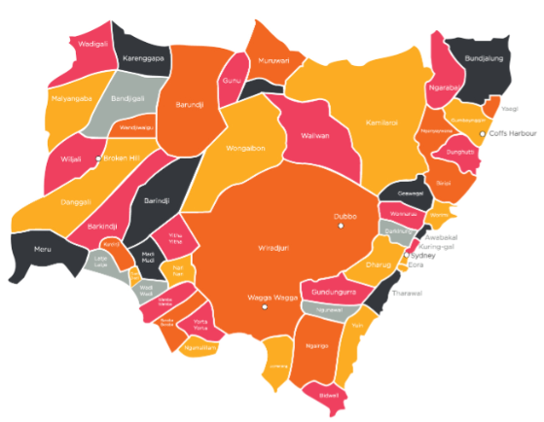
Acknowledgement of Country
I acknowledge the Traditional Custodians of the lands that we are meeting here today. I pay my respects to Elders past, present and emerging and celebrate the diversity of Aboriginal peoples and their ongoing cultures and connections to the lands and waters and skies of NSW.
I also acknowledge and pay my respects to our Aboriginal and Torres Strait Islander people joining us today.

Slide 3
Homelessness Innovation Fund (HIF)
The HIF has been allocated $30 million in 2024-25, for two grant programs:
  Reforming Temporary Accommodation.
  Service Reform and Innovation.
The first assessment tranche is now complete.
Applications for the next tranche is now open and will close on 14 February 2025.
More information online on DCJ website:
  HIF Grant Program guidelines.
  HIF Grant Program FAQs (to be updated soon).
  Recordings of three online information briefings.
Both HIF grant programs will remain open until 30 April 2025.
Organisations can submit an application at any time within that period.

Slide 4
Quick overview
Overall 93 applications received by 30 October 2024 (first tranche).
24 grants offered in the first tranche, almost $10million
15 offered for Service Reform and Innovation
9 offered for Reforming Temporary Accommodation
https://www.nsw.gov.au/grants-and-funding/service-reform-and-innovation-grant-hif#toc-most-recent-recipients
https://www.nsw.gov.au/grants-and-funding/reforming-temporary-accommodation-grant-hif#toc-most-recent-recipients

Slide 5
Housekeeping/ Reminders

Slide 6
Requirements and the Process
Public Liability: needs to be current or purchased at time of submission, and minimum $10M
Items above $2000: need one quote attached to proposal
Project Plan: please use the one provided as it contains items that need a response
Partial Funding: The recommendation may be for partial funding. Applicants have the option to agree or decline the proposed funding.
Cut-off date for assessments: applications are not reconsidered at each assessment round, only those submitted between cut-off dates for assessment rounds.
Defining costs: applications need to be clear about how the funding will be applied. Vague ‘operating costs’ lines were excluded, marked down or considered for partial funding to avoid BAU or general operating costs.

Slide 7
How things are assessed

Slide 8
Statewide Impact: projects that are location specific are not penalised, but locations and value for money taken into account in the final list of recommendations by the Panel.
Sustainability, beyond the grant: this is a key assessment point and considers what impact the grant has beyond the grant period.
Clarity of impact: proposals need to clearly state how many clients, how much accommodation, the product produced, so that the impact of the proposal is defined.
Clarity of cohort management: proposals for congregate accommodation or communal spaces needed to identify if there was a target cohort or how different cohorts would be managed. For instance single men and women, or where children are included.
In-kind contributions: be clear on the support provided from an existing service including office space, management and training of staff, access to other facilities, community relationships. It is all of value.

Slide 9
General feedback on success

Slide 10
Successful themes
Additionality: where something existed beyond the period of the grant, proposals were marked up. This could include a new model made available broadly, continuing accommodation, or a new collaboration.
Meanwhile or interim use: conversion of existing buildings like offices, halls, retirement accommodation were marked up. Leasing was also a well-articulated value for money proposition.
New types of services: coming at the issue from a new angle or filling a gap in the service system for a particular area or cohort was marked up.

Slide 11
Unsuccessful themes
Ongoing or ‘gap’ funding: projects that were funding existing services were marked down, as were projects that would be closed at the end of the funding.
Referral processes, generalist ‘pathway’ support: proposals to make referral support more available (for example to TA) were marked down where there was not a clear link to additional outcomes or opportunities.
Funding staffing rather than services: linking to the need for clearly defined outputs, proposals that were primarily for additional staffing only were marked down. An alternate way to package it is to request funding for a service such as a set number of assessments or plans completed.
Unclear impact on target clients: some proposals were for community level support, making the impact on target clients or reduction in demand on TA difficult to measure.
Negative consequences of the project: for some proposals to be stood up it appeared that existing clients would be relocated or have services reduced. Proposals needed to be clear on why that provided an overall benefit.
Project sustainability: Proposals that did not provide clear detail around sustaining projects and client supports beyond the grant period were marked down.

Slide 12
Next steps

Slide 13
Future assessment rounds
Applications for the next assessment tranche closes on 14 February 2025.
Applications for the final assessment tranche closes on 30 April 2025.
Please review successful grants as published.

Slide 14



For further information on the HIF, please visit
https://dcj.nsw.gov.au/housing/homelessness-innovation-fund.html
For further information on applying, please review:
Grant Program Guidelines
Frequently Asked Questions (FAQs).
For program enquiries contact shsprogram@homes.nsw.gov.au
Apply by submitting you application through SmartyGrants portal
20

